Slide 1
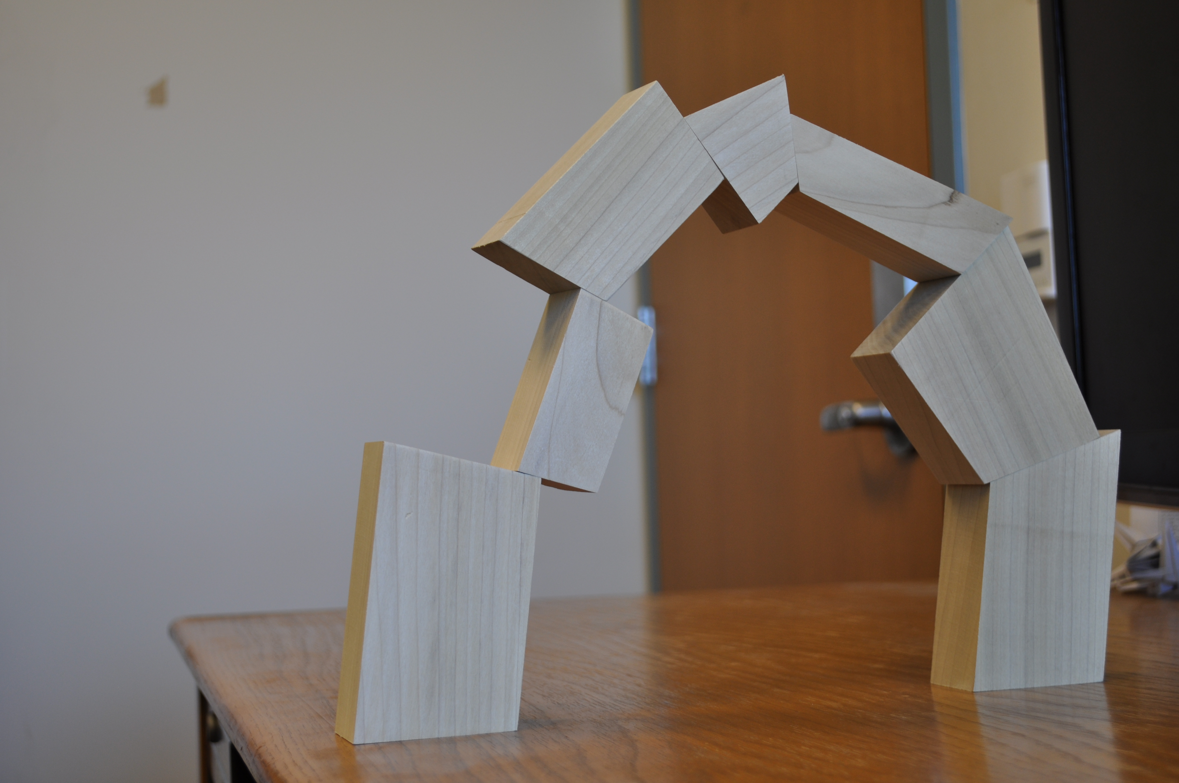
Generating Design Suggestions under Tight Constraints with Gradient-based Probabilistic Programming
Daniel Ritchie Sharon Lin Noah D. Goodman Pat Hanrahan
Stanford University
Notes:
The focus of my talk today…

Slide 2
Design Suggestions
Notes:
…is design suggestions

Slide 3
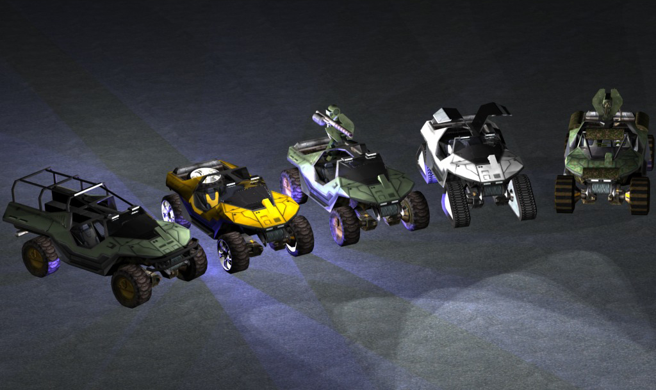
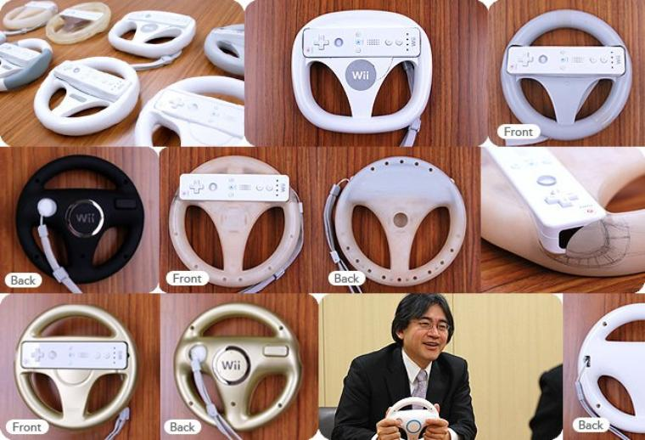
Creating a variety of content…
[Bungie]
…Prototyping a single artifact
[Nintendo]
Notes:
Whether your goal is to create a lot of content, maybe for a computer game…
…or whether you’re iteratively prototyping just one product…
Being exposed to a lot of different good alternatives is valuable.
Not surprising that researchers have tried to build systems for automatically generating these alternatives.

Slide 4
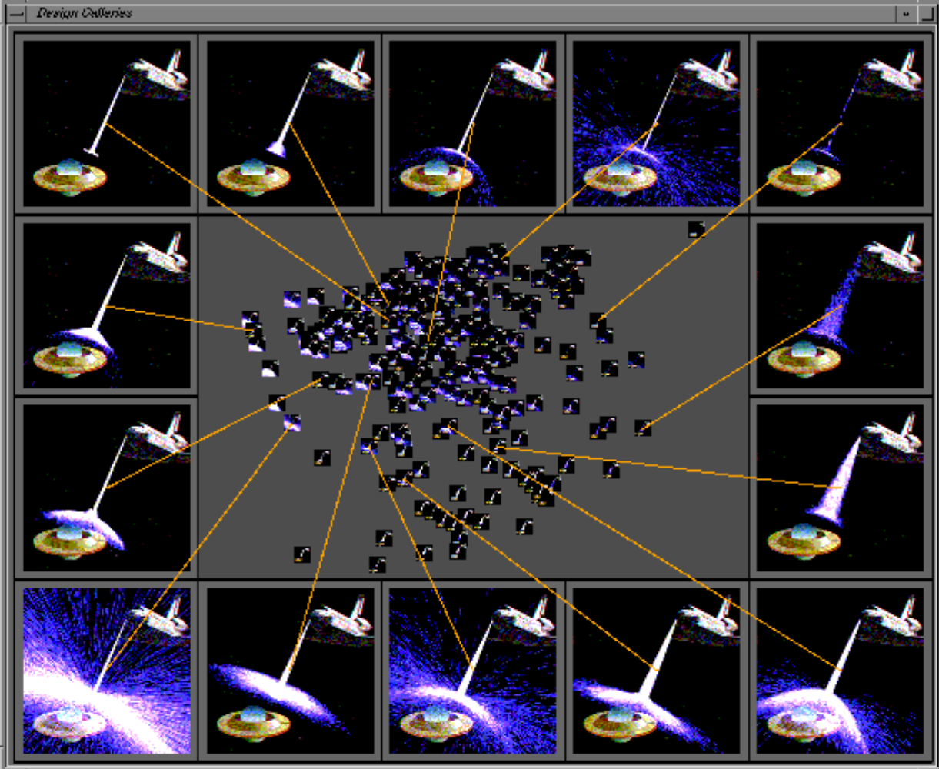
Design Galleries
[Marks et al. 1997]
Notes:
Goes back at least to the well-known Design Galleries work almost 20 years ago.
Presents a dimensionally-reduce map of a parametric design space – here, the parameters control the appearance of a particle simulation.
Lets the user drill down into areas of interest.

Slide 5
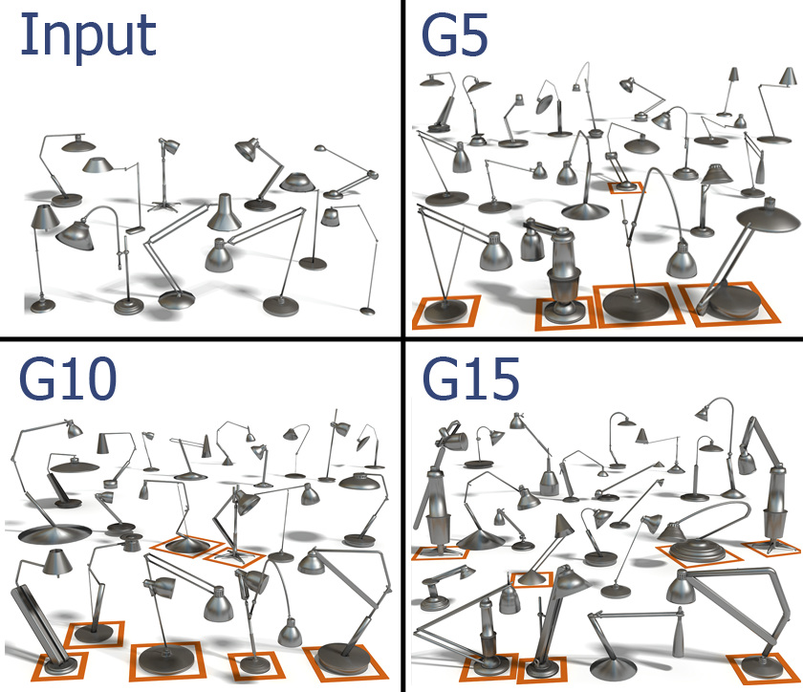
Genetic Algorithms
[Xu, Zhang, Cohen-Or, Chen 2012]
Notes:
People also use GA.
Evolve and combine features of different designs using mutation and crossover to create new generations of suggestions.
As in this shape modeling example.

Slide 6

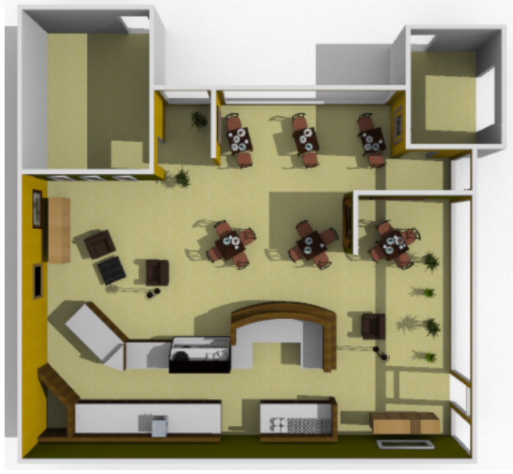
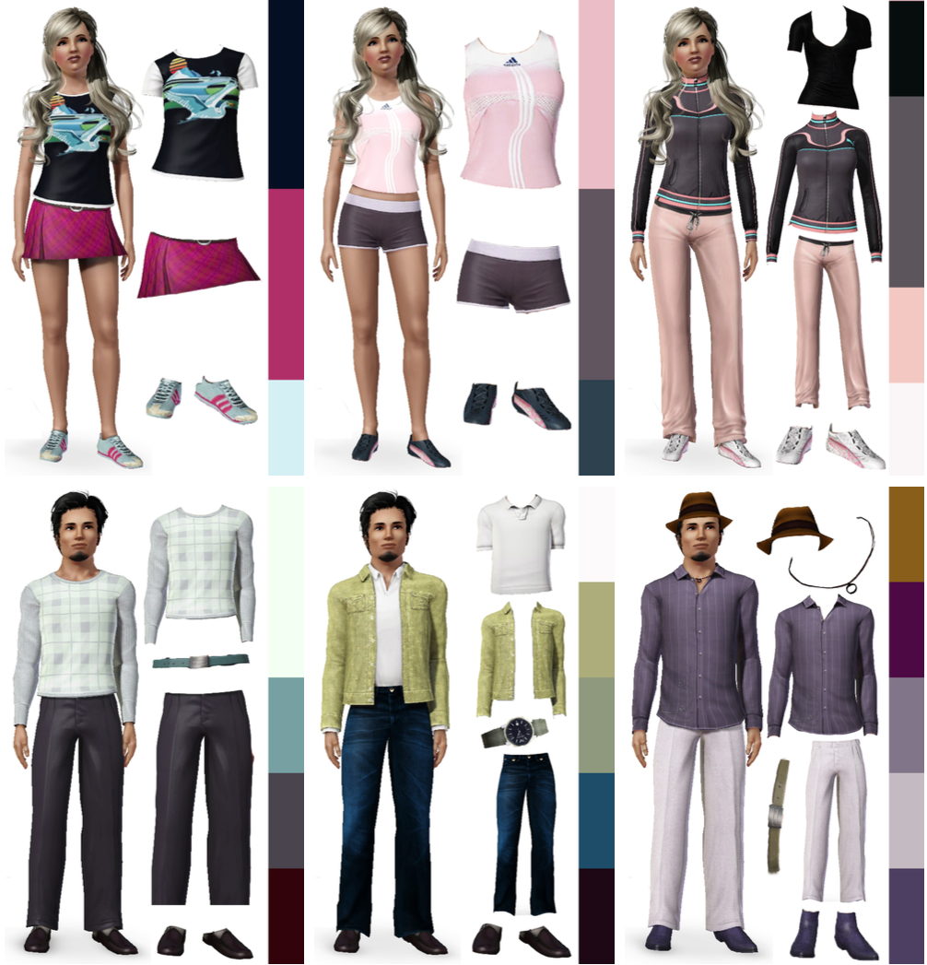

Probabilistic Models
[Talton et al. 2011]
[Yeh et al. 2012]
[Lin et al. 2013]
[Yu et al. 2011]
Notes:
Recently, lot of work on using probabilistic models.
From arranging furniture…to shaping the output of procedural models…to dressing virtual characters…to coloring in images.
Idea is to express design criteria as terms in a probability distribution, then sample from the distribution.
To do that…

Slide 7
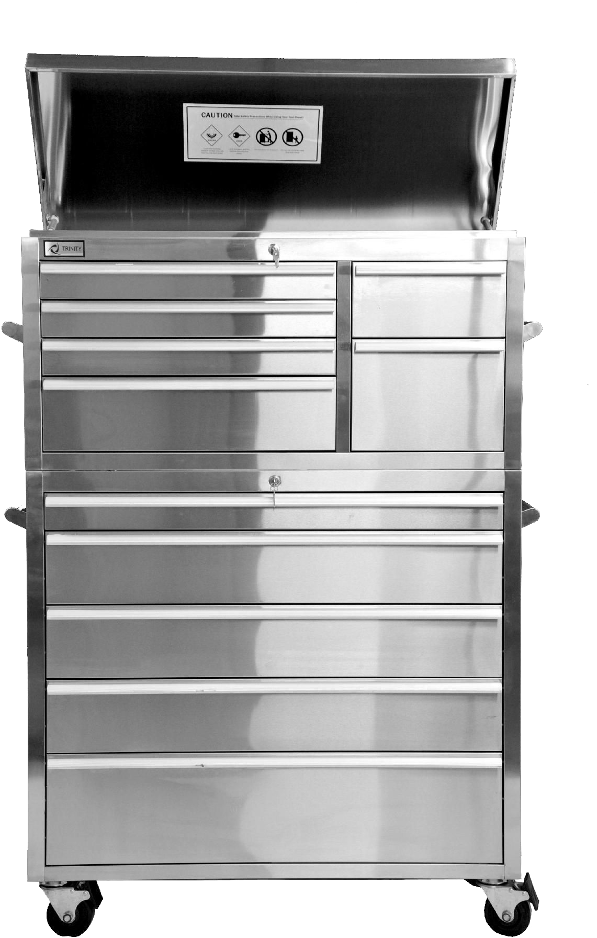
The design sampling toolbox
Notes:
…these systems tend to draw methods from a common toolbox of sampling algorithms.

Slide 8
Metropolis Hastings
Notes:
The main workhorse of these methods is the Metropolis Hastings algorithm
A brief refresher (or introduction, for those who haven’t seen it before).

Slide 9

Metropolis Hastings
Notes:
For simplicity, imagine we have a 2D design space, and probability mass is concentrated like this (blob).
MH starts out in some random initial state, then proposes small random changes to it.
These changes are accepted or reject randomly, in proportion to the change in probability.
If those changes increase probability (or at least don’t lower it to much), they’re likely to be accepted, and we continue.
If they lead to a big enough drop in probability, we likely reject that change and continue on from previous state.
In the limit, this process explores the complete space, and the time it spends in any region is proportional to that region’s probability.
Of course, this picture is a huge oversimplification. Many design spaces…

Slide 10

Many Design Spaces Look Like This
Notes:
…look more like this.
Many isolated, ill-shaped regions of high probability.

Slide 11
Problem: ‘Mode Lock’
Notes:
One issue that crops up in scenarios like this one is what I’ll call ‘mode lock.’
Starting from a state in one region, it can be very hard to randomly generate a proposal that moves to another.
It may happen occasionally, but most proposals will fall somewhere in this nether-realm of low probability.

Slide 12
Annealing + Tempering Methods
Notes:
Fortunately, there are tools in the toolbox for addressing this problem.
Annealing and tempering methods, such as parallel tempering.

Slide 13
Melting Down Distributions
Notes:
These methods work by ‘melting down’ probability distributions…

Slide 14

Melting Down Distributions
Notes:
…taking these ‘peaks’ of high probability and redistributing their mass across the space…

Slide 15

Melting Down Distributions
Notes:
…which makes the separation between different regions less drastic.
This makes it possible to jump between modes by making the penalty for falling in between them less severe.
Unfortunately, this picture is *still* an oversimplification. Because *actually,* many of the most interesting problems…

Slide 16

…Actually, Design Spaces Look Like This
Notes:
…look like this. They’re so high-dimensional and complex that we can’t faithfully visualize them at all.

Slide 17
?
Notes:
For these kinds of problems, there’s no solution that just works straight out of the toolbox.

Slide 18
Metropolis Hastings
Application-Specific Customizations
Notes:
Application designers (and these are typically researchers) have to take some existing tool, such as MH, and make application-specific tweaks and customizations to make it work for them.

Slide 19
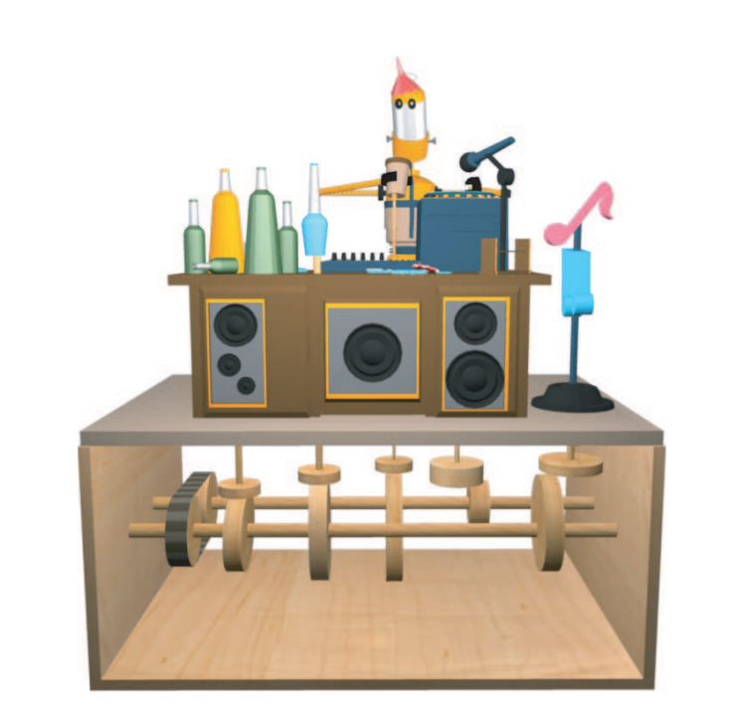
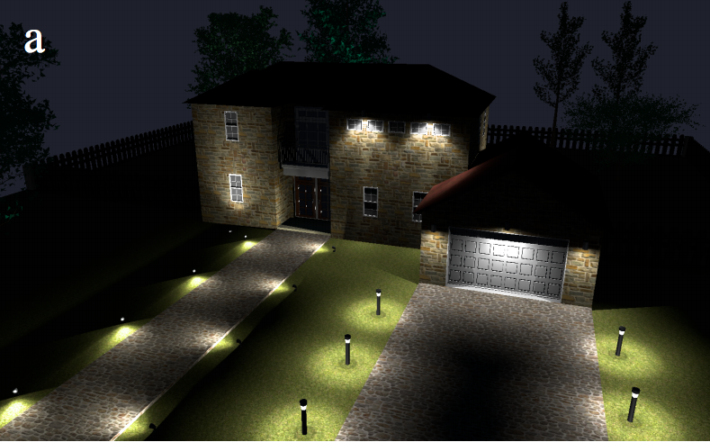
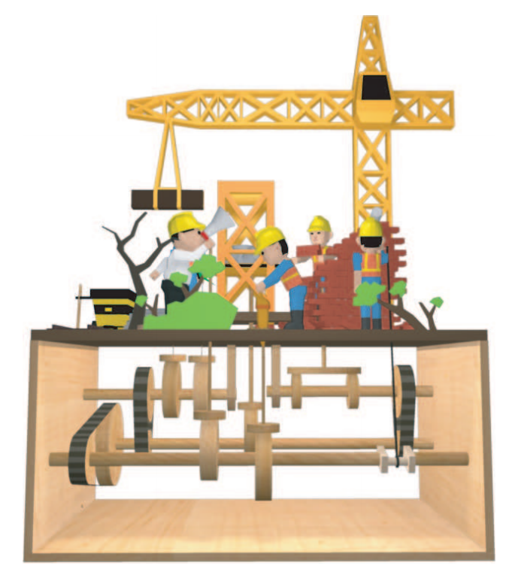
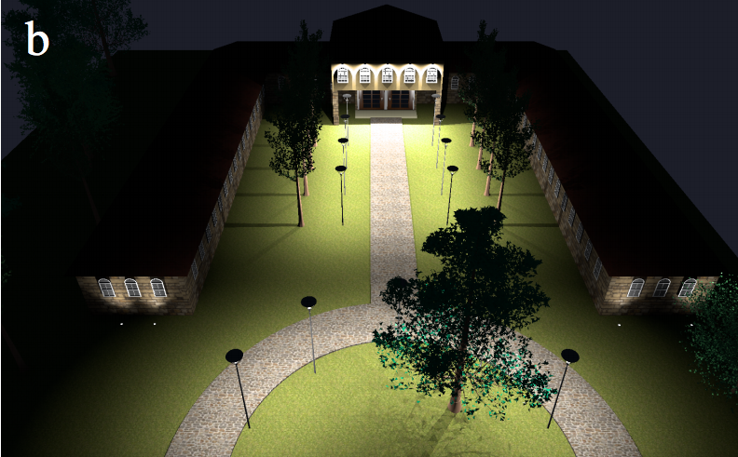
Applications Using Customized Tools
Notes:
I want to briefly highlight two examples of recent work that use customized MH samplers to efficiently navigate a design space.

Slide 20
Mechanical Toy Modeling [Zhu et al. 2012]
Specialized gear
merge/split proposals
Domain-specific heuristics for constrained sampling
Notes:
Presented at SIGGRAPH Asia a couple of years ago.
Goal is to infer the interior mechanism that will drive the motion of the exterior objects in a way that resembles a target motion.
Sophisticated custom MH proposals to detect when it’s possible to split and merge connecting gears.
Heuristics for coordinated sampling of some variables while holding others fixed.

Slide 21
Exterior Lighting Design [Schwarz & Wonka 2014]
Proposals maintain all constraints explicitly
Domain-specific heuristics for compound proposals
Notes:
Recent work on exterior lighting design for procedural buildings.
Presented at SIGGRAPH last year.
Goal: provide sufficient illumination to specified regions, while satisfying constraints about what kinds of lights can go where.
Carefully designed proposals that always maintain constraints
Heuristics for making proposals to multiple variables that are likely to increase probability.

Slide 22
High Reward…for High Effort
Carefully-Coordinated Proposals to Multiple Variables
Notes:
Both are super clever solutions to hard problems that generate results efficiently…but they each took a lot of effort to develop.
And they each solve one, specific problem.
They had to go to all this effort to customize their own tools, because the tools in the general toolbox weren’t good enough
Worth asking: are there any features that these two have systems in common that might be worth finding a general solution for?
Yes: very carefully coordinated proposals to multiple variables.

Slide 23
Problem: Tight Constraints
Notes:
This tactic is necessary in the presence of tight constraints, where the values of multiple variables are strongly coupled.
Geometrically, this leads to narrow ridges of high probability.
Standard MH’s random proposals will occasionally stay on these ridges…
…but more often they’ll fall off of it, and the sampler will end up geting stuck for long periods of time.
I’ve drawn this in 2D, but this particular problem obviously gets even worse in higher dimensions.

Slide 24

Gradients
Hamiltonian Monte Carlo
Notes:
To address this problem generally, I’m going to propose adding a new method to the design sampling toolbox:
Hamiltonian Monte Carlo, or HMC.
Developed in statistical physics, and fairly familiar to Bayesian statisticians, has not been used in graphics for computational design.
At a high level, works by incorporating the gradient of the probability distribution into its random proposal strategy, which, as I’ll show, allow it to take pretty big steps without straying off into low-probability oblivion.
First explain how it works, then highlight some design applications we can build with it.

Slide 25
Hamiltonian monte carlo: how it works
Notes:
So first: how does HMC work?

Slide 26

Probability density
Notes:
Suppose we have some prob density that’s shaped like this
Again, normal MH’s random proposals aren’t really able to make progress here.
So how does HMC do it?
Let’s first take this ‘ridge’ of high probability…

Slide 27


Potential energy landscape
Notes:
…and invert it into a valley, which we’ll call a potential energy landscape.
Precisely, this is the negative log of the probability.

Slide 28

Initial state
Notes:
Next, we’ll place a little ball—a point mass, really—somewhere in this valley.
This’ll be our initial state x.

Slide 29
Initial momentum
Potential
Kinetic
Total energy:
Notes:
Then, we give this ball a shove in some random direction and with some random force—this’ll give the ball its initial momentum p.
We can now write down the total energy of the physical system described by this ball: potential energy, plus kinetic.
Where kinetic is just momentum squared.
Now we get to where Hamiltonian Monte Carlo gets its name—from Hamiltonian dynamics. For our next step,

Slide 30
Simulate for time steps of size
Notes:
We simulate this physical system forward for some fixed number of discrete, finite-sized time steps.
And this is where the use of gradients comes in.

Slide 31

Simulate for time steps of size
Notes:
(Play again, if need be).

Slide 32

Final state
, momentum
Accept with probability
Notes:
After the simulation ends, the ball is in some new position, which we’ll call our final state x prime.
And it has some new momentum, which we’ll call p prime.
Finally, in a step very similar to Metropolis Hastings, we flip a coin and accept this state change with probability proportional to the old total energy - the new.
So if energy decreased, we’re guaranteed to accept, and if it increased, we might accept if it didn’t increase too much.
By repeating this process, we can efficiently explore all up and down this valley.

Slide 33

Step Size
Too Small
Too Large
Dual Averaging
[Nesterov 2009, Hoffman & Gelman 2014]
Notes:
You might’ve noticed during that last explanation that there are a couple of parameters we need to specify for HMC. The first is step size epsilon.
If it’s too small, then HMC just sort of tiptoes around the state space and doesn’t explore very efficiently.
If it’s too big, then as anyone who’s ever done any physical simulation can tell you, the simulation becomes unstable and explodes.
To avoid having to hassle with this, we ended up automatically adapting the step size to each problem using an online optimization approach, dual averaging, that was developed in previous work.

Slide 34
Trajectory Length
Too Small
Too Large
Notes:
That leaves the other parameter, trajectory length – the number of simulation steps we take before doing an accept/reject test
If it’s too small, then we lose the benefit of gradients: the motion of the proposal is dominated by the random initial momentum, and we get an aimless wandering behavior much like standard Metropolis Hastings.
But interestingly, we can also have problems if the trajectory length is too long.
Trajectories can get so long that they can hit soft ‘walls’ in probability space, and then double back on themselves, wasting computational time.
In practice, this is the only free parameter that we still need to set by hand for each problem, using trial-and-error.

Slide 35
Implementation
Notes:
Want to touch briefly on a general-purpose implementation strategy for HMC

Slide 36
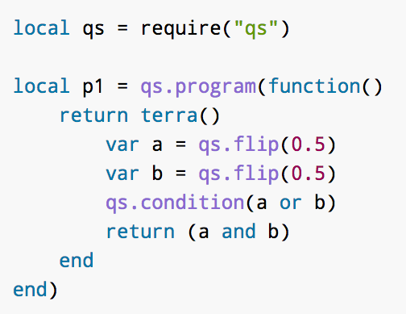

Probabilistic Programming
Quicksand Source Code
Generative Model
Makes Random Choices
Imposes Penalty Terms
Returns Design Artifact
Compiler
Random Choice Values
Update State
Executable Machine Code
Accept / Reject
Automatic Differentiation
Compute HMC Proposals
Notes:
…which is to use probabilistic programming.
We did this by representing our models as programs in Quicksand, which is a PPL that we developed earlier.
These programs are generative models.
They make random choices, such as flipping coins or drawing from gaussian distributions.
They then impose penalty terms on values calculated by the program.
And ultimately, their return value is some design artifact, such as a mechanical structure or a colored image.
These programs get compiled to executable machine code, which when run, outputs a design artifact.
But it also, as a side-process, generates a few other quantities which let us do sampling.
The first is the trace of values for all random choices the program made when running.
It also computes the log probability of these values, according to the distributions from which they were drawn, as well as any penalty terms
And finally, it also gives us the gradient of this log probability, which it computes without any user intervention via automatic differentiation.
As I described earlier, we use this gradient in the computation of HMC proposals…
…which perturb and update our current state, as defined by the random choice values.
And then we compare the probabilities of the old and new states to determine whether to accept or reject.

Slide 37
Example Applications
Notes:
With all of that technical explanation out of the way, let’s look at some of what we can do with HMC.

Slide 38
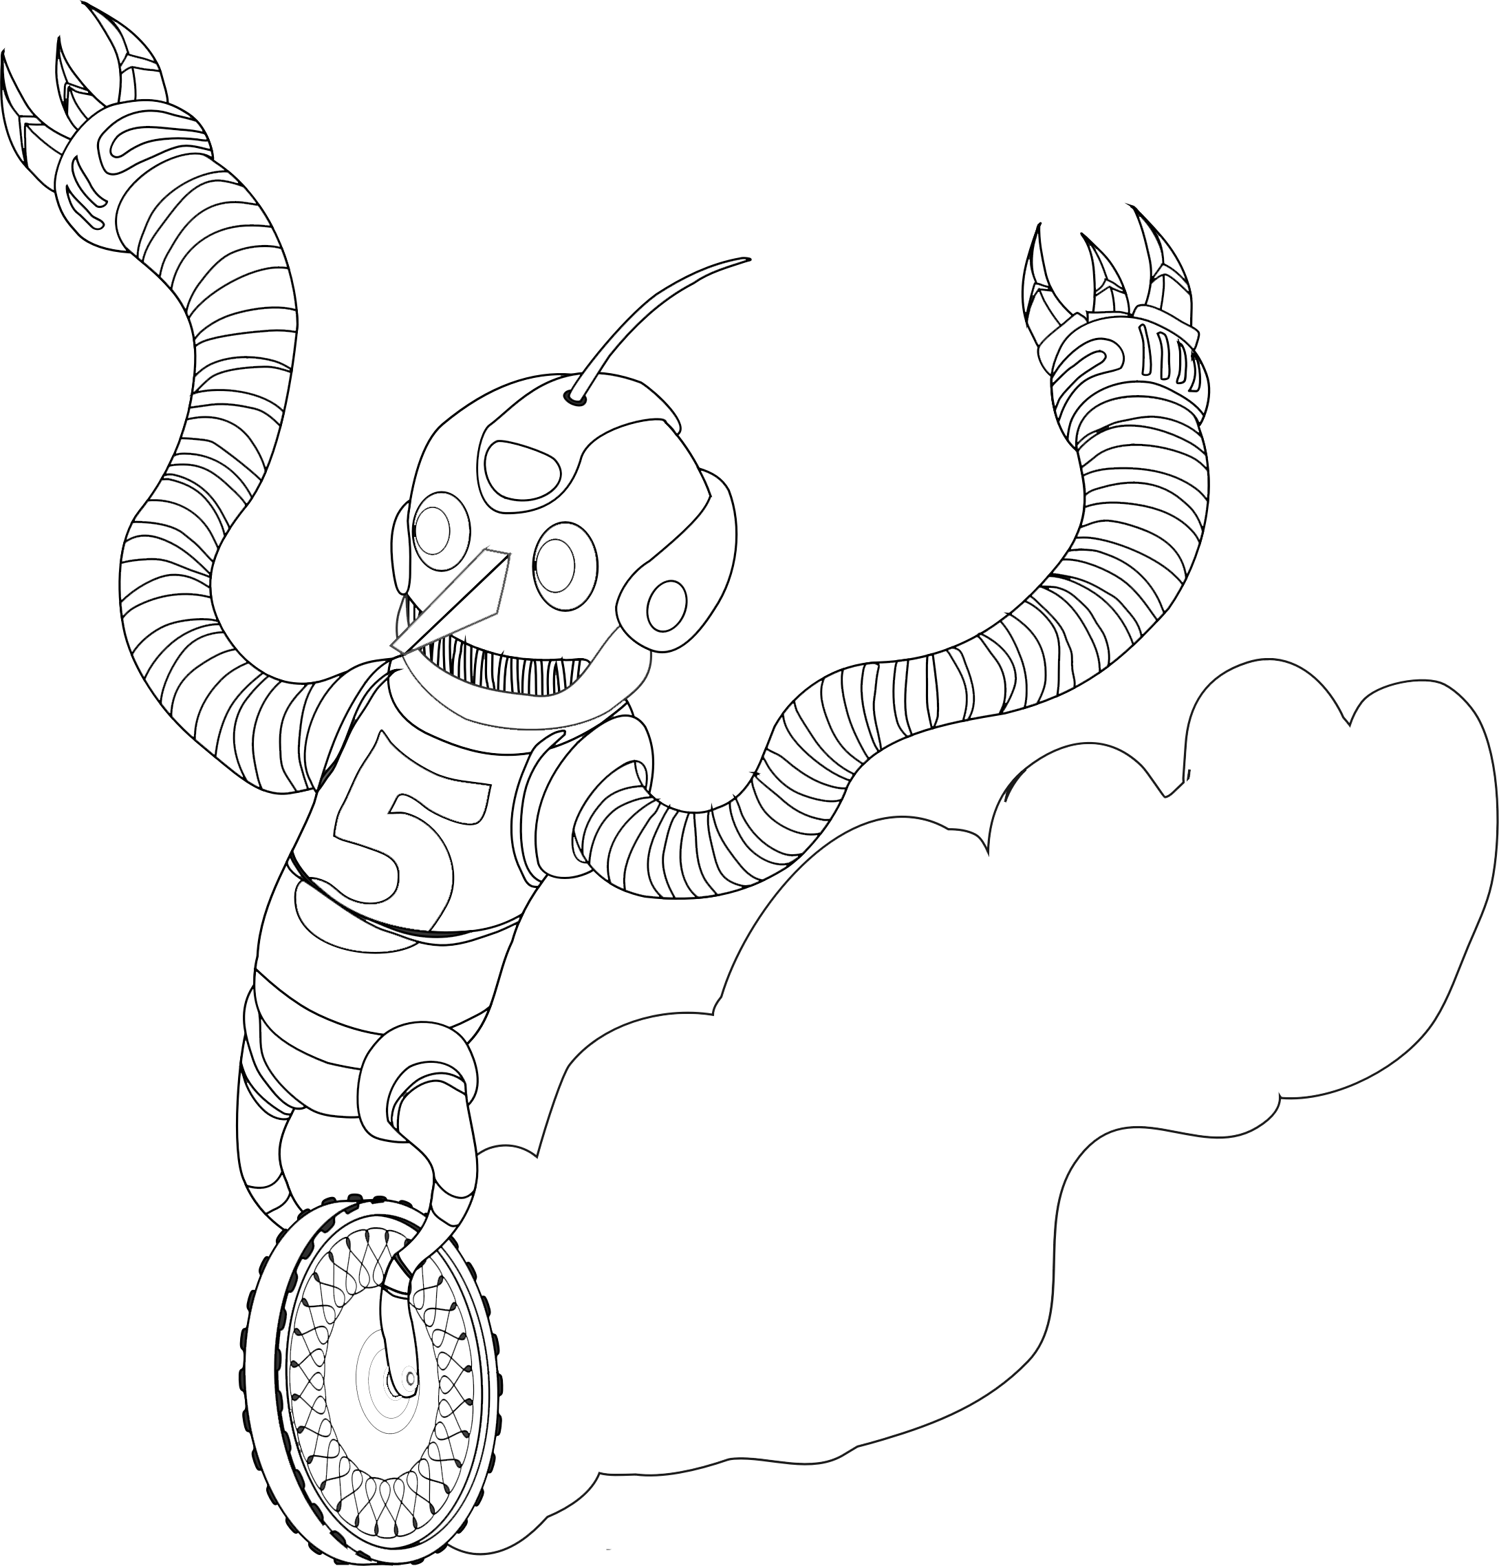
Vector Art Coloring
Pseudocode
colors = genRandomColors()
logprob -=
constraintResidual(colors)
1
2
[Lin et al. 2013]
Notes:
First app we’ll look at is Vector Art coloring.
By that I mean assigning colors to each closed region of an image such as this one.
This is similar to the work on pattern coloring that we presented at SIGGRAPH a couple years ago.
We’ll use some of the terms in that model, but we’re going to focus on new types of constraints that require HMC.
By way of example, let’s add a constraint between these two regions (dust cloud and ground).
What relationships might we want to enforce here?
First, how about that chroma should be approx equal? (dust is just kicked from the ground, so should be roughly same hue).
Then, let’s say dust cloud should be darker—let’s say lightness half of ground lightness.
The pseudocode for expressing this as a prob prog looks like this:
First sample random colors for each region…
…then evaluate constraints, and subtract any residual from the overall log probability of the model (penalizes us for not satisfying constraints)
Our intuition is that if constraints are made tight enough, MH will struggle, and we’ll need HMC.

Slide 39


Vector Art: MH vs. HMC
MH
HMC
Notes:
So let’s compare the two, then, and see how they do on coloring this robot example.
What we have visualized here is a random initial coloring configuration, and we’re going to show the time dynamics of each sampler, basically the sequence of accepted proposals.
MH wiggles around the state space a little, but it never strays very far from initial configuration.
Now let’s see HMC.
HMC, in addition to being more psychedelic, does a much better job of exploring different coloring possibilities. After a while, has completely moved away from its initial configuration.

Slide 40
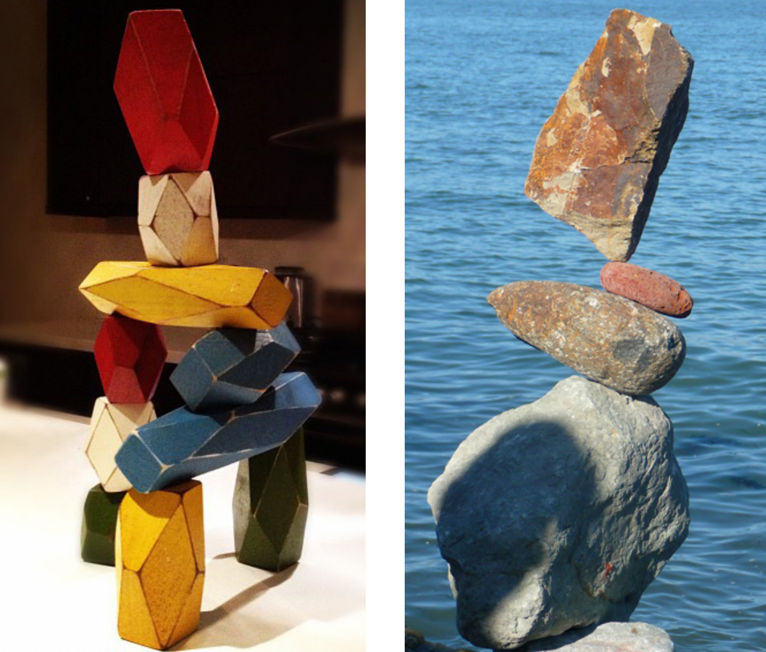
Notes:
That’s it for vector art coloring.
Another example we’ll look at is stacking structures.
Free-standing structures made of stacking components
Like this block tower
Or this rather-impressive rock balancing act.

Slide 41
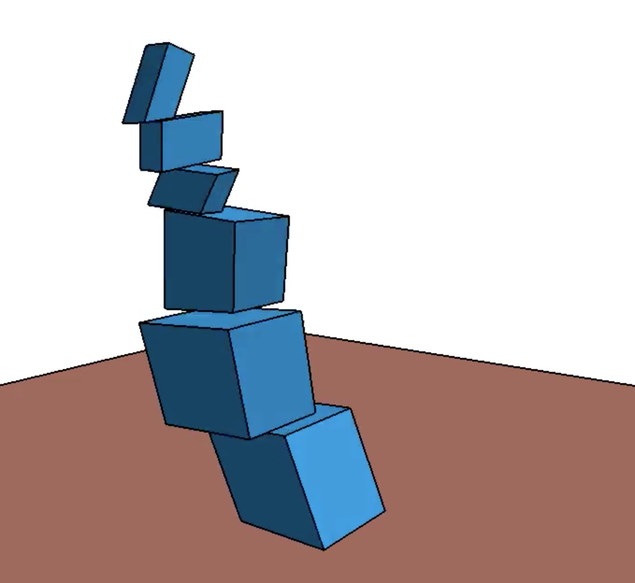
Stacking Structures
Pseudocode
s = genRandomStruct()
f = genRandomForces(s)
logprob -=
forceResidual(s, f)
Notes:
Here’s how we’ll formulate the model.
First, we’ll write a program that generates a random stacking structure, in this case a random tower.
Then, at each of the contact surfaces between two blocks…
…we sample a set of random contact forces.
Our constraint is that when we sum up all the forces and resulting torques acting on each block, that sum should be zero---that’s the static equilibrium condition.
So we’ll take whatever residual is left over from this sum and use it as a penalty, subtracting from the models overall log probability.

Slide 42
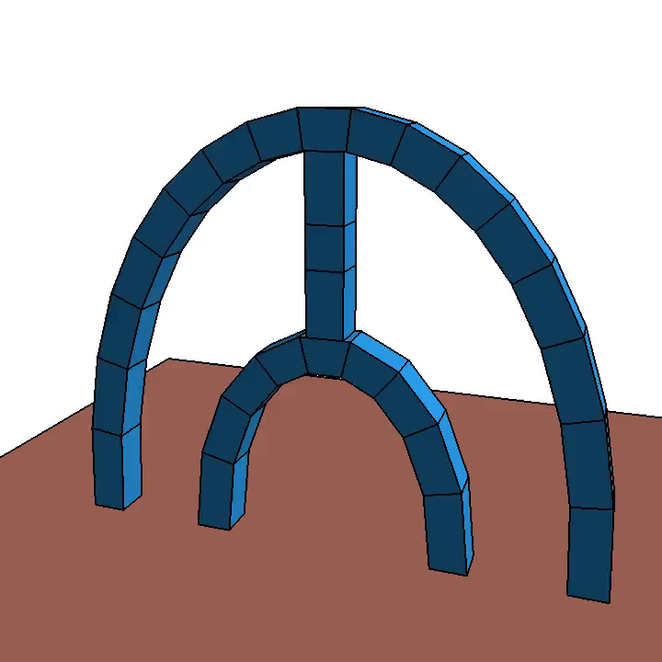
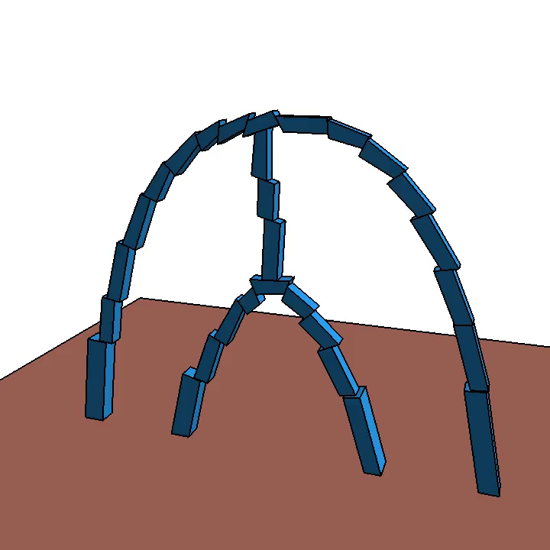
Stacking: MH vs. HMC
MH
HMC
Notes:
Again, let’s compare how MH and HMC fare when trying to stable explore variations of this arch-like structure.
MH again gets stuck pretty quickly—it dives right toward one stable configuration and hangs out there indefinitely.
HMC, on the other hand, rapidly travels through a pretty wide range of different and unexpected stable configurations of this structure.

Slide 43
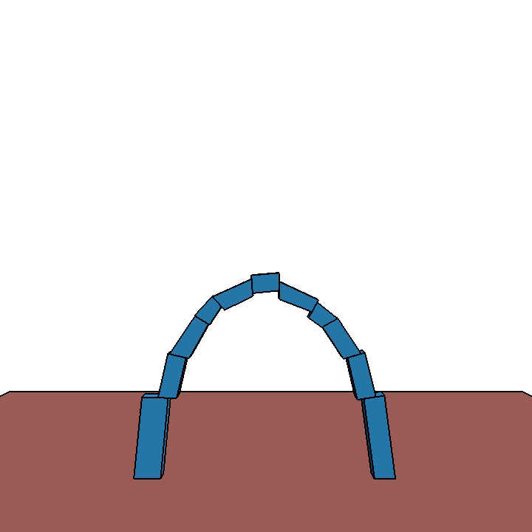
Enforcing Symmetry
Pseudocode
s = genRandomStruct()
f = genRandomForces(s)
logprob -=
forceResiduals(s, f)
sr = reflect(s)
logprob -= vertexDiff(s, sr)
Notes:
When we were working with this block stacking program, we discovered that with just a small modification, we could also get it to enforce approximate symmetry, as well.
Here’s how it worked.
We take our program from before…
…and we reflect the generated structure about the vertical axis.
Then, we look at corresponding pairs of block vertices between the original and reflected structure, and we compute the positional error there, again subtracting that as a penalty from the overall log probability.
And with that little change, we can use HMC to sample structures like these, which are nearly bilaterally symmetric.

Slide 44

Physical Realization
Notes:
We also used this program to generate blueprints for a few physical structures, to verify that the things our system was generating actually are stable.
So here’s one result we built, an interestingly asymmetric arch structure.

Slide 45
HMC Limitations
Setting Trajectory Length
No-U-Turn Sampler
[Hoffman & Gelman 2014]
Non-Differentiable Models
Smooth Interpretation
[Chaudhuri & Solar-Lezama 2010]
Hard Constraints
Constrained Hamiltonian Monte Carlo
[Brubaker et al. 2012]
Notes:
The L parameter is free and we have to set it manually. There is a sophisticated variant of HMC, the No-U-Turn Sampler, that effectively adapts trajectory length on the fly, to achieve good exploration while avoiding the ‘doubling back’ behavior I illustrated earlier.
Since HMC relies so heavily on gradients, models that aren’t everywhere differentiable pose a problem. This crops up when using functions such as min or max, or when evaluating more complex functions that have discontinuities, such as rendering a 3D scene to an image. Fortunately, a lot of these functions can be made useable by smooth relaxation, and for more complicated cases, there’s a technique called smooth interpretation that can generate a smooth approximation to any program. We haven’t tried it yet, but we think it’s promising.
HMC is great at exploring distributions that form narrow ridges in probability space, but if that ridge actually collapses to an infinitely thin manifold, as is the case with truly hard constraints, then HMC can’t guarantee exact adherence to that manifold.
There is an extension of HMC, called CHMC, that does guarantee this by incorporating an explicit manifold projection step, though at the cost of more computation time.

Slide 46
Notes:
(pause)
That just about does it for my talk, but before I wrap up…

Slide 47
Hamiltonian Monte Carlo
Notes:
…I want to revisit the design sampling toolbox from the beginning of the talk.
Hopefully I’ve convinced you that HMC should be a key tool in our arsenal of general-purpose sampling techniques for design.
It’s not a cure-all: it addresses one specific problem, that of tight constraints.
Fortunately, we’re starting to see more research targeting general-purpose solutions to particular design sampling problems.

Slide 48
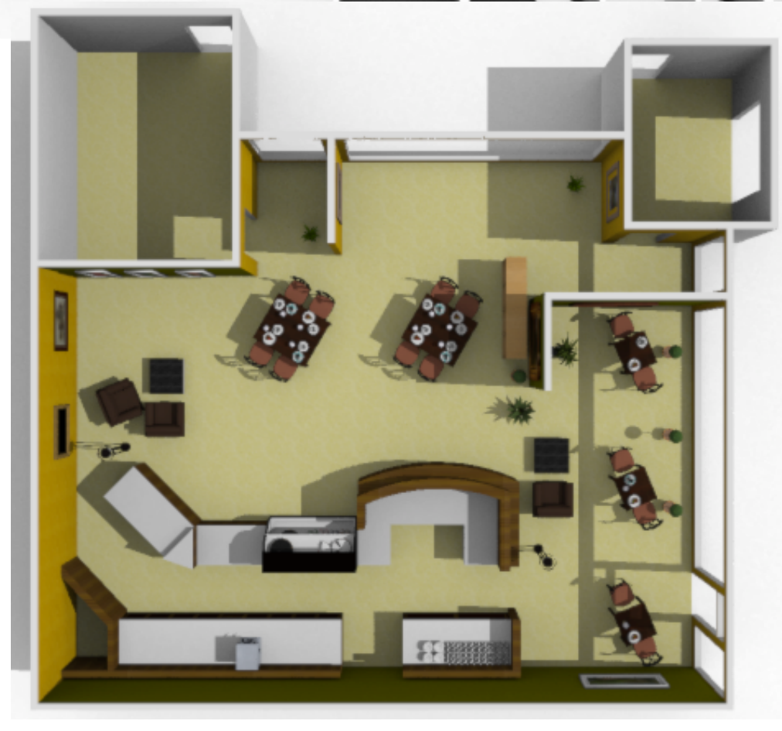
LARJ MCMC
[Yeh et al. 2012]
Notes:
There’s Locally-annealed reversible jump MCMC, which tackles models with a lot of structure-change.
By structure-changing, I mean where the number and type of objects is variable, like in this furniture layout example.
LARJ-MCMC tries to make proposals that jump between different structures accepted more frequently, so samplers don’t get stuck.

Slide 49
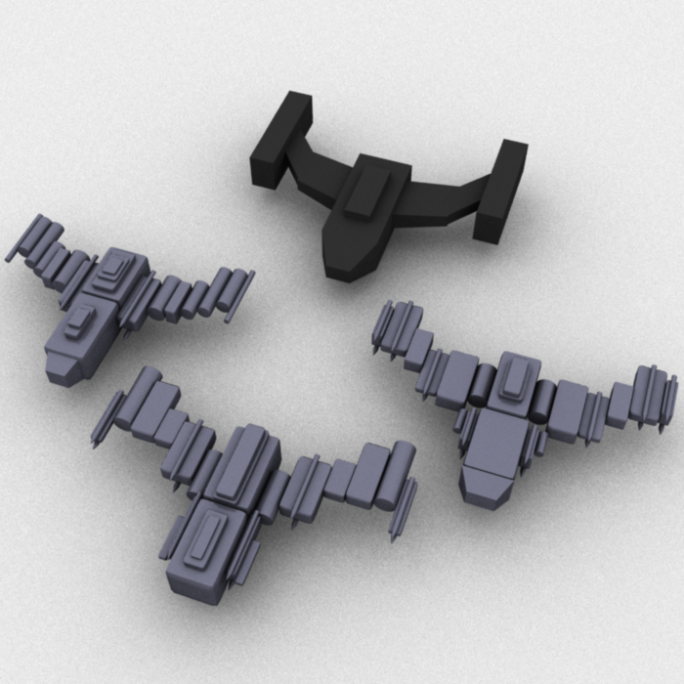
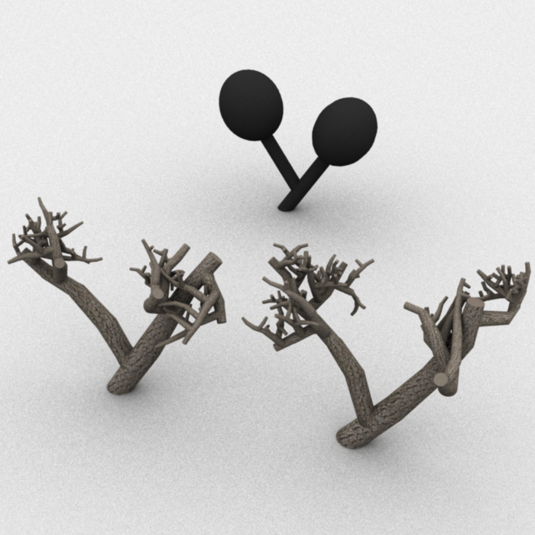
Sequential Monte Carlo
[Ritchie et al. 2015]
Notes:
And in a couple of months, at SIGGRAPH, I’ll be presenting a new variant of Sequential Monte Carlo sampling that also helps with structure changing models, particularly when those models feature long chains or trees of dependent variables.

Slide 50
Notes:
These are all good tools, and having them is a great start.
But we’re far from done.

Slide 51
Not There Yet
Notes:
If we look back at these two applications I highlighted earlier, then my assessment is that
We’re not there yet, in terms of being able to match the performance of their hand-tuned algorithms with our general-purpose ones.
So what can we do to make progress here?

Slide 52
Not There Yet
Program Analysis?
Learning to Sample?
Automatic Method Selection?
Notes:
One avenue for future work is program analysis. If we represent our models as programs, as we’ve been doing, we can examine their data dependencies and control flow structures, and we might be able to extract program invariants or other static properties that can lead to better samplers.
If we can’t do this statically, we might be able to do it dynamically, by learning as the sampler runs how to sample better, looking at what moves seem to be working and which ones aren’t.
And finally, there’s the question of how to select which general-purpose methods are best suited for a particular application. Ideally, we’d build systems that can do this automatically and behind-the-scenes, so that all users have to do is write down their models and press go to get interesting and useful design suggestions.

Slide 53
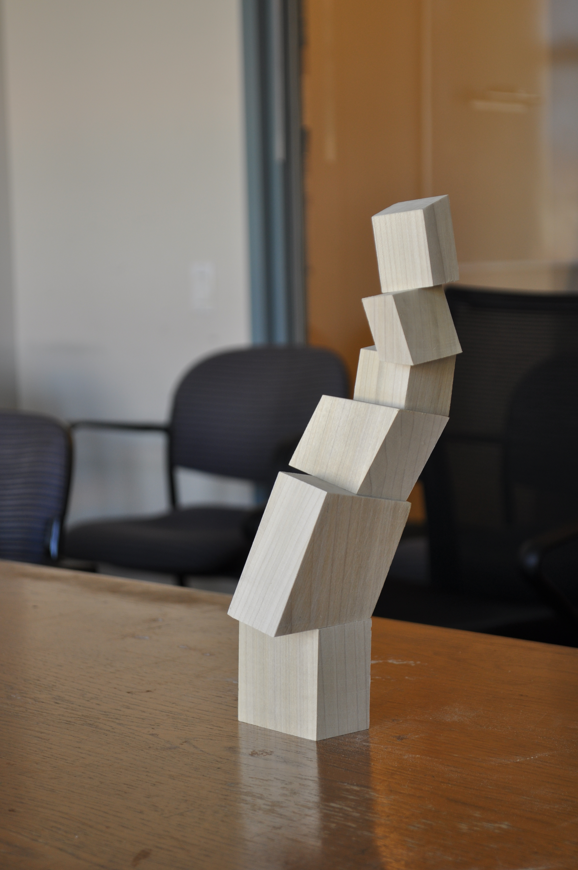


Thanks!
Quicksand:
dritchie.github.io/quicksand
Example Applications:
github.com/dritchie/graphics-hmc
Notes:
And with that, I’ll end my talk.
Just want to point out that the source code for this project is available online.
‘Thanks for listening, and I’d be happy to take questions.

Slide 54
Performance Timing
Robot
94 samples/second
Wheel
1 sample / ~3.5 seconds
Notes:
More detailed timing data in the paper, including comparisons to MH timing.

